Slide 1
“The Grace Of God”
False Grace (part 2)
Continual Cleansing
All verses are from NKJV unless noted.

Slide 2
Previously:
Nicolaism, seemingly that grace covers licentious pleasures (Rev. 2:6, 14, 15; 2:20, 21)
Universalism, grace saves everyone
Catholicism, grace dispensed by clergy through sacramental rites
Calvinism, grace unalterably extended to the (unconditionally) predestined elect

Slide 3
Another perversion of the grace of God
Neo-Calvinism
Continual cleansing
What is meant when one talks of “continual cleansing?”
Claim: Continually made clean from personal sin after one obeys the gospel (1 Jn. 1:7; Rom. 4:7, 8)
A related doctrine to Calvinism’s “Once saved, always saved”
Notes:
(For those who do not like all of John Calvin’s teaching and add or take away from it to fit their view of grace)
They claim that the blood of Jesus cleanses from sin like a wiper blade cleans the windows from the drops of rain. As sin happens it is immediately and automatically wiped away. Variations of this doctrine exist. Some think he has to maintain a good attitude. So as long as one has a good attitude he can indulge in a sin and not have his soul threatened of being lost.

Slide 4
major in Hypotheticals…
A man lusts after a woman while driving; he dies in a car wreck without a chance to repent….
Supposed to prove a security for the soul and disprove the need to repent and confess of sin
Why do they not use a hypothetical of a man committing adultery with a woman and getting killed?
Actually some have!
Could be used to prove other false ideas:
Used against the need to be baptized by wrecking and dying on the way to get baptized
Used against the need to believe by wrecking and dying before hearing about Jesus
Yet belief and baptism are required (Mk. 16:16)!

Slide 5
Is The Faithful Saint Continually Cleansed By The Blood Of Jesus Christ?
“First of all, it should be pointed out that the question is self-contradictory. How? It speaks about the blood continually cleansing. 1 John 1:7 tells us that his blood cleanseth us from sin. So, if the blood is continually cleansing, it is continually cleansing from sin, which means that there is sin present that needs cleansing. That being true, the person who is being continually cleansed must be continually sinning. Now, how can a person be called a faithful saint (both terms) while at the same time he is continually sinning? Clearly, the question contradicts itself.” (Hiram Hutto, Guardian of Truth, XXXI: 16, pp. 491, 492)

Slide 6
Shall We Continually Sin?
Romans 6:1, 2, “What shall we say then? Shall we continue in sin that grace may abound? Certainly not! How shall we who died to sin live any longer in it?”
Grace does not abound when we “continue in sin!”
Notes:
What should Paul have said if he endorsed continual cleansing? He should have said, “YES, and we can remain faithful to God in that sin because the blood of His Son continually cleanses us.”

Slide 7
Shall We Continually Sin?
Same Word
1 John 3:7-10,
7 Little children, let no one deceive you. He who practices righteousness is righteous, just as He is righteous.
8 He who sins is of the devil, for the devil has sinned from the beginning. For this purpose the Son of God was manifested, that He might destroy the works of the devil.
9 Whoever has been born of God does not sin, for His seed remains in him; and he cannot sin, because he has been born of God.
10 In this the children of God and the children of the devil are manifest: Whoever does not practice righteousness is not of God, nor is he who does not love his brother.”
#4160
“works” (LO)
Notes:
“works sin” is justified by the Greek and gives clarity that John is talking about and contrasting a manner of life.
“Practices” (v. 7, cf. 1 Jn. 1:6; 2:29). One “brings forth” righteousness and another “brings forth” sin.

Slide 8
Shall We Continually Sin?
1 John 3:7-10,
7 Little children, let no one deceive you. He who practices righteousness is righteous, just as He is righteous.
8 He who sins is of the devil, for the devil has sinned from the beginning. For this purpose the Son of God was manifested, that He might destroy the works of the devil.
9 Whoever has been born of God does not sin, for His seed remains in him; and he cannot sin, because he has been born of God.
10 In this the children of God and the children of the devil are manifest: Whoever does not practice righteousness is not of God, nor is he who does not love his brother.”
What Does This Mean?
A Christian lives perfectly after converted?
Once saved you are always saved?
If one sins, it is automatically covered by grace and cannot be seen by God?
?

Slide 9
Truth
Is consistent and does not contradict itself
Requires “context”
Is opposed to isolating passages from others
“The entirety of Your word is truth, And every one of Your righteous judgments endures forever” (Ps. 119:160)
Must believe what the Bible says
Must believe only what the Bible says
Must believe all that the Bible says
Notes:
Context – etymology = to weave together. Hence the meaning of any verse is so often understood joined together within a context.

Slide 10
When Sound Rules For Biblical Interpretation Are Dead, False Doctrine Springs Forth

Slide 11
Abused Isolated phrases:
Examples
“My God, My God, why have You forsaken Me?” (Mat. 27:46)
To mean that the Father literally abandoned, and despised the Son (not reconciling Jn. 16:32; 8:28, 29)
“For Christ did not send me to baptize but to preach the gospel” (1 Cor. 1:17)
To mean that baptism is not a part of the gospel and is not essential for salvation (ignoring, 1:12-15, etc.)

Slide 12
CAN The Christian Sin?
YES!
1 John 3:7-10,
7 Little children, let no one deceive you. He who practices righteousness is righteous, just as He is righteous.
8 He who sins is of the devil, for the devil has sinned from the beginning. For this purpose the Son of God was manifested, that He might destroy the works of the devil.
9 Whoever has been born of God does not sin, for His seed remains in him; and he cannot sin, because he has been born of God.
10 In this the children of God and the children of the devil are manifest: Whoever does not practice righteousness is not of God, nor is he who does not love his brother.”
The Truth Teaches:
A Christian can sin (1 Jn. 1:8, 10, 2:1; 5:21)
A Christian can fall away from grace (1 Jn. 2:19; Gal. 5:4; Heb. 3:12; etc.)
If one sins, he is to confess and turn from it so that it does not lead to death (1 Jn. 1:9; 5:16, 17)
?

Slide 13
What Then Does John Mean?
“Whoever abides in Him does not sin” (1 Jn. 3:6)
“Whoever has been born of God does not sin” (1 Jn. 3:9)
“We know that whoever is born of God does not sin” (1 Jn. 5:18)
John is contrasting the habitual practitioner
Satan habitually sinned from the beginning (3:8)
Those who are of Satan likewise habitually practice evil (e.g. of Cain, 3:12)

Slide 14
What Then Does John Mean?
“Whoever abides in Him does not sin” (1 Jn. 3:6)
“Whoever has been born of God does not sin” (1 Jn. 3:9)
“We know that whoever is born of God does not sin” (1 Jn. 5:18)
In Christ there is no sin (3:5)
Therefore those who are born of God and abide in Him practice righteousness, not sin (3:6, 7)
The seed (influence of the word) remains in him convicting him to not sin (3:9)

Slide 15
Shall We Continually Sin?
NO!
For those in Christ, sin is the exception, not the rule!
Must use care to not justify or minimize sin as something normative to living life—it is of the devil!
The case of Simon (Acts 8:18-24)

Slide 16
1 John 1:5-9
Condition Specific
“If we confess our sins…” (1:9)
1:5
God Is Light
1:7
If We Walk In The Light
FELLOWSHIP 1:7 BLOOD OF JESUS
With One Another
Cleanses From All Sin
1:9
If We Confess Our Sins
FAITHFUL 1:9 AND JUST
Forgive Our Sins
Cleanse All Unrighteousness
Notes:
This passage speaks of God’s provision for when we sin. There is a solution for when the Christian sins, so that he can be back in God’s good grace.

Slide 17
Example of David
6 just as David also describes the blessedness of the man to whom God imputes righteousness apart from works:
7 "Blessed are those whose lawless deeds are forgiven, And whose sins are covered;
8 Blessed is the man to whom the LORD shall not impute sin."
ROMANS 4:6-8

Slide 18
ROMANS 4:6-8
“imputes” (reckons, calculates, charges)
*The Blessed Man*
God reckons righteous
(apart from works)
Does Not Charge Sin
“Righteousness” defined here as having sins “sent away” and not charged to your account!
1. Lawless deeds forgiven
2. Sins covered
Notes:
“forgiven” – sent away, left, depart, go away, abandon (note, “left” Matt. 4:11, 22; 8:15)

Slide 19
ROMANS 4:6-8
“imputes” (reckons, calculates, charges)
*The Blessed Man*
Context is discussing Abraham (4:1-5)
Likewise, David was fundamentally saved like Abraham
Not saved by works (perfect law keeping)
The law brought condemnation to those under it (3:9, 10, 19-22; 4:14)
LAW manifested their sins but could not save them from sin
Abraham was justified before the LAW was given

Slide 20
ROMANS 4:6-8
“imputes” (reckons, calculates, charges)
*The Blessed Man*
Context is discussing Abraham (4:1-5)
Likewise, David was fundamentally saved like Abraham
Abraham was saved by having a justifying faith (Rom. 4:9-12)
Not by circumcision, but by faith walking where God wanted (4:12, 13)
“Steps of Faith”
We likewise must have that type of faith to be reckoned as righteous!
Notes:
This is trusting obedience

Slide 21
“Steps of Faith” (Rom. 4:12)
“They answered and said to Him, ‘Abraham is our father.’ Jesus said to them, ‘If you were Abraham’s children, you would do the works of Abraham’” (Jn. 8:39)

Slide 22
ROMANS 4:6-8
“imputes” (reckons, calculates, charges)
*The Blessed Man*
Like Abraham, David was not saved by works or perfect law keeping (4:1-5)
Abraham “believed” God, and “it” was accounted to him for righteousness (4:3)
His “faith” is accounted for righteousness (4:5)
Injecting righteousness
Imputing Christ’s righteousness
NOT
NOT

Slide 23
ROMANS 4:6-8
“imputes” (reckons, calculates, charges)
*The Blessed Man*
Like Abraham, David was not saved by works or perfect law keeping (4:1-5)
Abraham “believed” God, and “it” was accounted to him for righteousness (4:3)
His “faith” is accounted for righteousness (4:5)
Perfect law keeping
Faith imputed righteousness
YES!
NOT

Slide 24
It Matters What Is Charged To Our Account!
“imputes” (reckons, calculates, charges)
Faith is Credited
OR
Sin Is Credited
Sin Is Forgiven
Faith Is Unseen
Blessed!
Not Blessed!
No “faith working through love” (Gal. 5:6; Jas. 2:21-26)
“May it not be charged against them” (2 Tim. 4:16)
Notes:
Faith buried in a coffin will not save. It must be living, walking and loving. It must be active and moving. It must be trusting and obeying.

Slide 25
No Automatic Wiper In Romans 4:7, 8
The Blessed Man (Ps. 32:1, 2)
Sin is forgiven
Sin is covered
Lord does not impute iniquity
HOW?

Slide 26
No Automatic Wiper In Romans 4:7, 8
The Blessed Man (Ps. 32:1, 2)
Not by keeping silent (32:3)

Slide 27
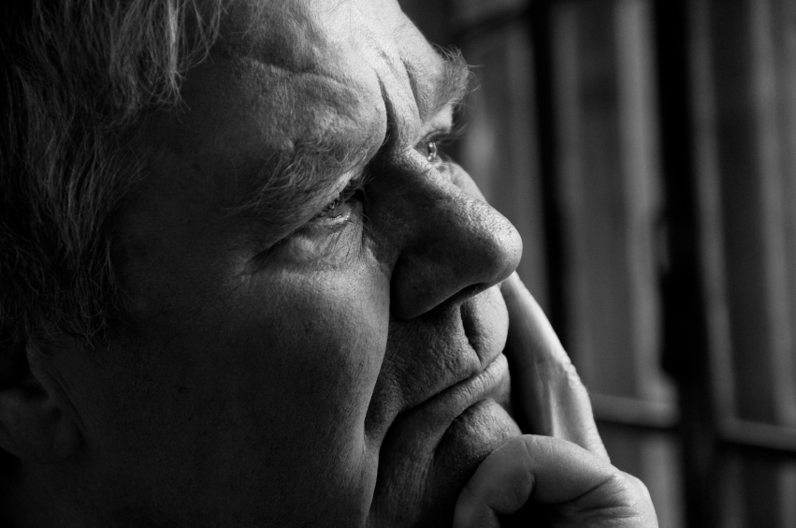
“When I Kept Silent”
My bones grew old
Groaning all the day long
Your hand was heavy on me day and night
Vitality turned into the drought of summer
Notes:
When I kept silent- David describes his silence which is the effect of seeking to be deaf to God’s displeasure. Does it sound like David subscribed to continual cleansing?
This is a vivid description of the physical manifestation of sin which is suppressed, and not acknowledged. Such should be the case of person who has a heart after God but has committed sin. It is healthy to have these effects of sin.
The bones growing old would have the effect that David felt as if he were prematurely aging. His strength was sapped. He went around groaning in a distressed spirit all day long. It never really left him though he sought to leave it behind. Time doesn’t heal the scare of sin. Day and night passed with the heavy hand of God’s displeasure upon him. It is as if God’s hand was pressing down on him both in the day time and at night.
His vitality (lit. juice). This is the description of a man having his sap taken away from him. He was like a dried up dying tree with no moisture. We are familiar with what the hot summer heat can do, but what happens in a drought when there is no reprieve from the heat, when there is no rain to refresh?
We only hurt ourselves when we won’t confess our sins to God. The groaning, the breaking, the drying up of the well of life within us is but a mere reflection of the removal of God.

Slide 28
No Automatic Wiper In Romans 4:7, 8
Romans 4:7, 8
Psalm 32:1, 2
The Blessed Man (Ps. 32:1, 2)
By acknowledging his sin to God (32:5)
Stopped hiding and excusing it (32:5)
Confessed transgression to the LORD (32:5)
Then forgiven (32:5)
Quotes David
SO HOW?
David’s pardon is to encourage the godly who sin (32:6)
Notes:
Paul quotes from David in Romans 4 and is essentially telling us to look to his example. This is the way the gospel works for Christians today! But please take special note of confession. As repentance cannot be produced without godly sorrow, so the confession of sin cannot be done without the acknowledgment and recognition of sin. “If I hurt you” does not recognize the hurtful deed!

Slide 29
Pardoned By God
Paul serves as an example of being pardoned by God (1 Tim. 1:16)
His sins were washed away, not by performing the deeds of the law of Moses, but “through faith” in the step of baptism (Acts 22:16; Gal. 3:26, 27)

Slide 30
Pardoned By God
Paul serves as an example of being pardoned by God (1 Tim. 1:16)
David also serves as an example of a saint being forgiven after sin (Rom. 4:5-8; Ps. 32:1-6)
Not by the deeds of the law of Moses (context, 3:20, 21, 31-4:2)
But also by steps of faith (Rom. 4:12)
when David went to God in confession

Slide 31
If You Have Already Received The Grace Of God Through Baptism But Have Committed Sin…
Will you acknowledge that sin?
Will you confess that sin (1 Jn. 1:9)?
“And many who had believed came confessing and telling their deeds” (Acts 19:18)
Will you repent and send away that sin (Acts 8:22)?
“Also, many of those who had practiced magic brought their books together and burned them in the sight of all…” (Acts 19:19)

